Slide 1
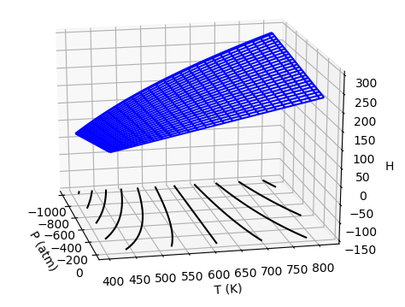
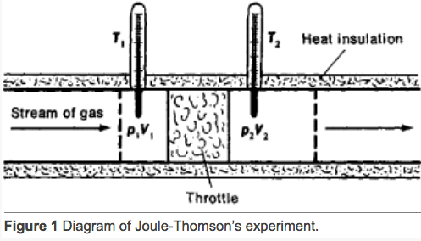
There’s an experiment for characterizing the twist … the Adiabatic Joule-Thomson experiment
A key feature of the Adiabatic Joule-Thomson experiment is that the gas follows an isenthalp (line of constant enthalpy) on its way out of the tank.
By measuring how much the temperature goes up or down along isenthalps, we characterize the twist!
https://encyclopedia2.thefreedictionary.com/Joule-Thomson+Effect

Slide 2
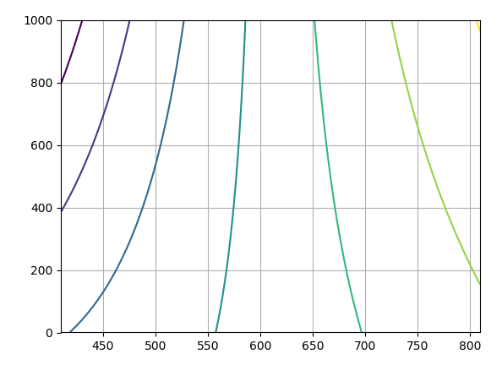


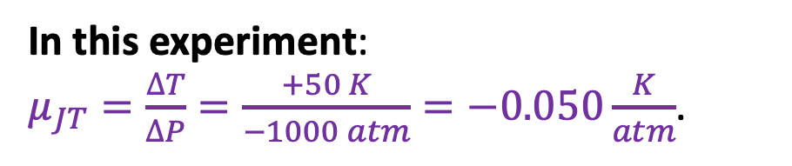
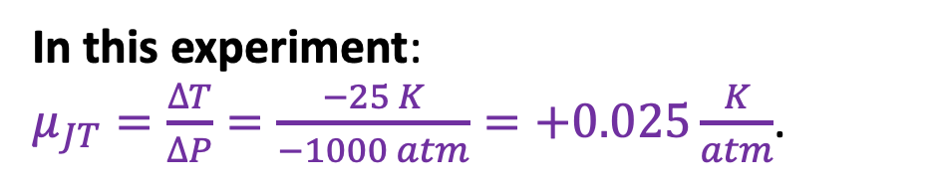
Quantitative results of this experiment: $\frac{∆T}{∆P}$
We’ll estimate the overall slope of each line by measuring $\frac{∆T}{∆P}$. See examples below
T (K)
In this experiment:
$μ_{JT}=\frac{∆T}{∆P}=\frac{+50 K}{−1000 atm}=−0.050\frac{K}{atm}$.
← P (atm)
In this experiment:
$μ_{JT}=\frac{∆T}{∆P}=\frac{−25 K}{−1000 atm}=+0.025\frac{K}{atm}$.

